Slide 1

The Dark Side of Operational Wi-Fi Calling Services
Notes:
why we need it. What is the difference between

Slide 2
Introduction
Wi-fi calling technology utilize 3gpp IMS system to provide voice service over wi-fi network.
Enabling user to dial outgoing call/receive call and texts through public and home network.
Consider an alternative solution for the case that users are in the area with weak signal of base station.
Even though wi-fi calling services include SIM-based security, 3gpp AKA and IPsec, still suffer from security threat
Notes:
3gpp: 3rd generation partnership project: bunch of operators and vendors get together and specify how mobile system works
AKA: authentication key agreement
By 2020, wifi calling will take 53% of mobile IP voice service usage. And because of this global deployment, there is a critical need for security investigation on wi-fi calling.
Wi-ficall differ from VoIP . Wifi call use signaling protocol and it is 3gpp specific version
Compared with conventional call, the major difference is that the traffic go through untrustful network. And this exposure to insecure network make the use of
wi-fi calling service security questionable
Similar to VoLTE their security mechanism based on IMS. Which include sim,aka and ipsec
Allowing mobile users to place cellular call over wi-fi network

Slide 3
Contribution
Vulnerabilities
Proof-of concept attack
Cause &
Recommendation
Insecure network
ARP spoofing
Side channel attack
Switching call
User privacy leakage
THDoS
VPN
Upgrade standards
Notes:
They explore security issues of the operational wi-fi calling services.
And conclude that current wi-fi calling security is not bullet-proof
The adv of using wi-fi call when you are in a place with no mobile network coverage

Slide 4
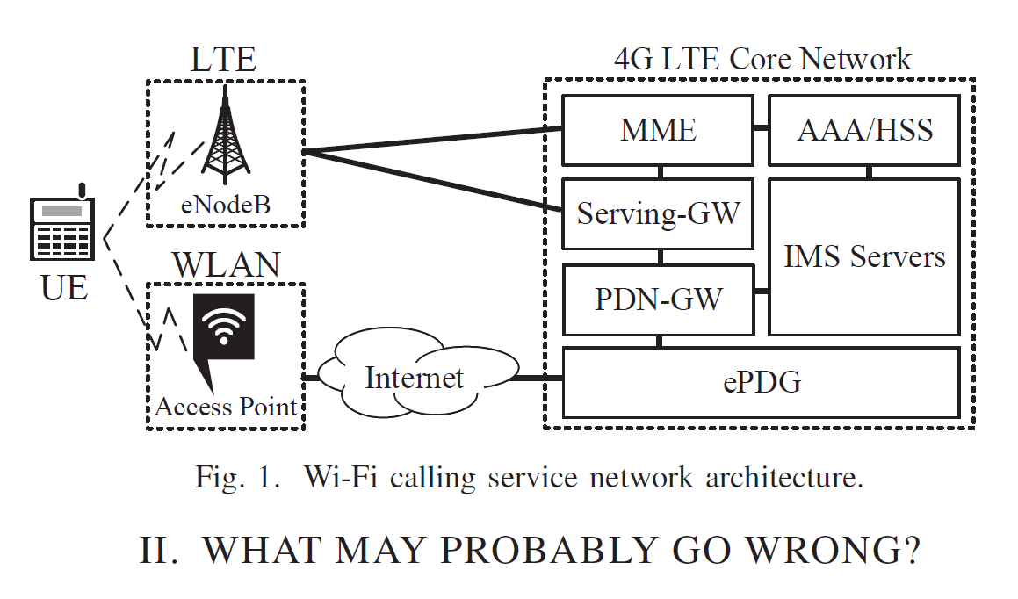
What may probably go wrong
Notes:
Consist of 2 main part: AP and LTE core network.
UE: consume the voice service supported by the core through wi-fi
The core consist of 4 main component
IMS: ip multimedia subsystem: it is part of 3gpp
ePDG: evolved packet data gateway
PDN-GW: public data network gateway
AAA server: authenticate, authorizaton, accounting
To enable the wifi calling service:
1- ePDG athenticate the user with assitante of AAA server
2- establish ipsec tunnel to its ue
3-epdg route packet between ue, pdn-gw and IMS server, which offer the wi-fi calling service
---
The operators own the base station but not the wi-fi network which raise some security concern
…………………….
Wifi calling similar to VoIP by using SIP with 3gpp modification as it is signaling protocol.
Main different: the service architecture which relies on cellular core network.

Slide 5
Vulnerabilities
Root in design defects of Wi-Fi calling standards (improper standard design)
Network Operational slip of operators
Implementation issues of Wi-Fi calling devices

Slide 6
How does it go wrong
Do wi-fi calling devices still activate wi-fi calling services while associating with an insecure wi-fi network?
Do any security mechanisms exist on the devices or/and the network architecture against threats?
Notes:
Exploring vulnerabilities in the standards, operational network, device implementation
Q1? Unfortunatly yes
Q2? Yes there are some security mechanism to defend against some attack but doesn’t eliminate the security threat completely
Ex: system switch mechanism: when the call cannot be reached (ex: the signaling packet cannot receive to user successfully), so switch back to celluler call VOLTE to prevent DoS attack. (where the packets are discard then consider the device is unreachable).
However, it doesn’t protect against some attack ex: dropping packets during the ongoing call

Slide 7
Vulnerability 1
Wi-fi calling device is unable to exclude insecure Wi-Fi network from their Wi-Fi selection
because current 3gpp network selection mechanism consider only connectivity capabilities but not the security risk.
standard design defect.
Notes:
Wi-Fi network selection mode: Manual and automatic modes.
manual: prioritized list of selected wi-fi network based on vendor-specific
automatic: the device is guided to do the selection by ANDSF
The selection is mainly based on the capabilities and the radio quality
Both mode doesn’t consider security risk of selected Wi-Fi networks.
ANDSF: (access network discovery selection function))

Slide 8
Vulnerability 2
Device do not defend against ARP spoofing /poisoning attack which can lead to various MITM attacks.
Consider a Common implementation issues of wi-fi calling services (device)
The attacker send spoofed ARP message onto a local are network to associate his MAC with IP address of the default gateway. Thus, is able to intercept the victims packet.
Notes:
ARP: address resolution protocol
The devicedo not advanced the wi-fi security

Slide 9
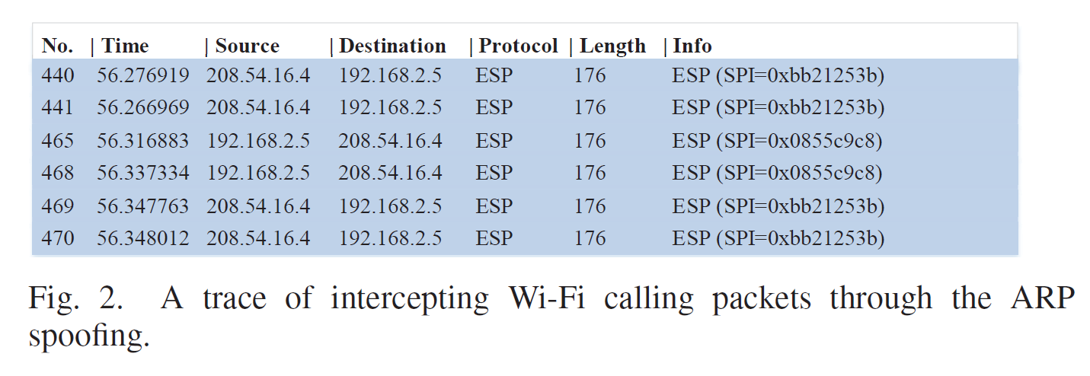
Notes:
Encapsolating security payload

Slide 10
Vulnerability 3
Even though wi-fi calling traffic is protected by IPsec, it is still vulnerable to side channel attack which lead to privacy leaking.
Consider an operational slip in the network infrastructure
The IPsec session between mobile device and the core network carries only Wi-Fi calling traffic. So traffic pattern can be learned to infer different events. ex: call status and text messaging status
Notes:
Therefore can maniplate the packet delivery

Slide 11
Vulnerability 4
Service continuity consider only the radio quality of wi-fi link but not the service quality. This is done by the triggers of 3gpp SRVCC/DRVCC procedure
infrastructure design defect
Even when the call performance is mute, the mechanism of service continuity is not effective. As a result, adversary is able to get the call stuck in malicious network.
Notes:
srvcc/drvcc : keep service continuity cross different radio access technologies: proposed for the purpose of keeping service continuity: it is initiated by the network infrastructure and triggered based on the radio quality condition of current serving base station bs and the nighbors bs: it imply the srvcc will not be triggered if the radio quality of the current serving bs is good.
Once the radio quality is good, the device wont switch to celluler-based voice even if the packets keep dropped.
It is operational slip of operators

Slide 12
Validation
Verify vulnerability 1: Devices in three operators’ network do not interrupt the connection with Aps under the attack
Verify vulnerability 2: Devices accept the ARP commands carried by the spoofed message; thus, failed to resistant ARP spoofing attack
Verify vulnerability 3: packets encrypted by IPsec can be analyzed and based on their pattern we can infer six events: dialing/receiving a call, sending, receiving a text and activate, deactivate the service.
Notes:
they set a network that it under ARP spoofing and and to verify the first vulnerability which is if the device will connect to an access point in this network . And yes all devices form different operatr they are connected and don’t inturrept the connection.
To verify vulnerability 2, they test the network for ARP spoofing using EtterCap. Which one computer claimed to be default gatway to the other device in the network. And the result was that all these devices accepted the ARP command and send the packets to the ttacker computer and as a result
Uplink: communication going from ground to satellite ()
Downlink: communication going from satellite to ground -- from wi-fi calling server to the callee
To verify vulnerability 3: they looked to these intercepted packets to see if they can infer some information.
The author believe that 3gpp should revisit current selection mechanism of wi-fi network calling services

Slide 13
Proof of concept attack
1- User privacy leakage
2- telephony harassment or denial of voice services (TDoS)
Notes:
They can bypass the security defense deployed on both mobile device and network infrastucture

Slide 14
First: User privacy leakage
WiCA tool, pattern analyzer for wi-fi calling traffic.
Analyzing encrypted packets to infer a wi-fi calling user’s call statics. Ex: who initiate the call, who hang up first, ringing and conversation time.

Slide 15
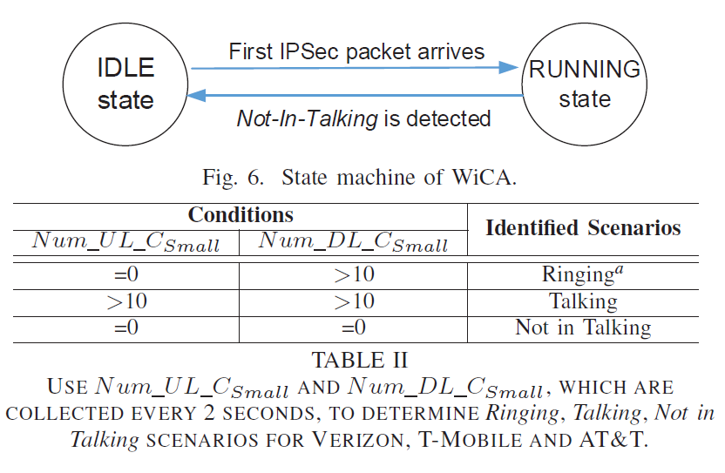
WiCA – call static extraction
Notes:
Call static extraction:
Idle is the initiate state
Step 1:
Ipec packet received> idle to running state
If it is from us> the event is dialing a call. Other wise it is receiving a call. Same go with terminating the call(see where the large data sip came from)
Step 2:
The system calssify the ipsec packet into 3 categories
1-Large >800 like sip packet
2-small <200 like voice packet
3-medium between 800, 200
Step 3: based on the rules on the table, the sys can discover 3 scenario
Ul:uplink, dl: downlink packets.
If no scenario is identified sys go to step 2
2- Evaluation:evaluate siCa performance on on 100 outgoing and incoming call.
The sys can know identify when the ringing start when the talking start and therefore can infer the duration of the ringning and the talking as well as who call and who hang up first
3-Negative impact:it can integrate in sys security tequnice where the the user can identified by voice recognition and also find out the user ipusing on campus or airport to prevent harassment and enhance security.

Slide 16
Second: telephony harassment or denial of voice services (THDoS)
1- wi-fi calling flow
2- Attack evaluation
Annoying incoming call attack
Zombie-Call Attack
Mute call attack
Telephony Denial-of-service attack
3- negative impact
Notes:
Based on manipulating of the delivery of wi-fi calling signaling and voice packets for an ongoing call.
Negative impact: experminet in micigan state university where 700 connected is served by the same gateway which is vulnerable to ARP spoof attack.

Slide 17
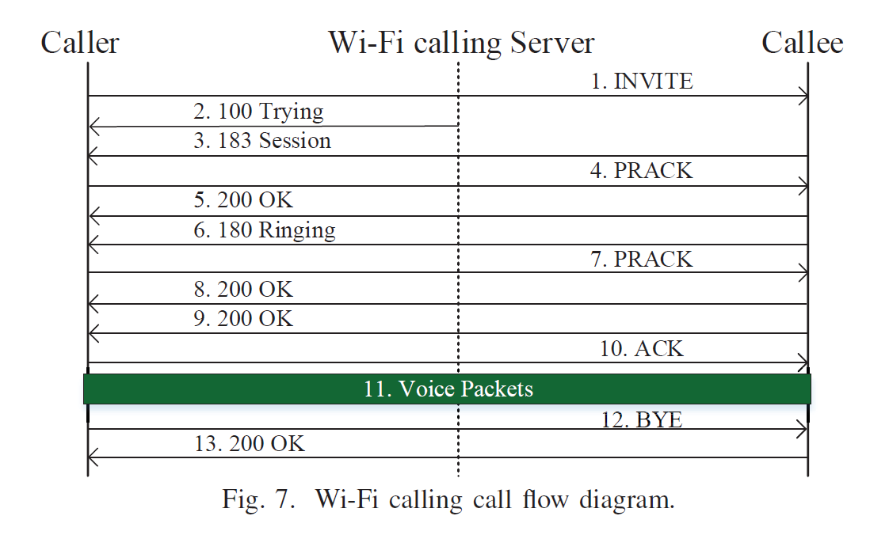
Wi-fi calling flow
Notes:
1- caller send SIP Invite message: to initiate the call
2- calling server reply 100 trying : to indicate that the call setup in progress
3- 183 session: contain list of chosen voice codecs
4-PRACK: inform the callee about selected codecs
Callee phone ring
5- 180 Ringing, so the caller phone ring
When the calle pick up his phone :They will exchange 200 ok and ack message
Finally : bye sent from the the end who terminate the call
The other end will send 200 ok

Slide 18
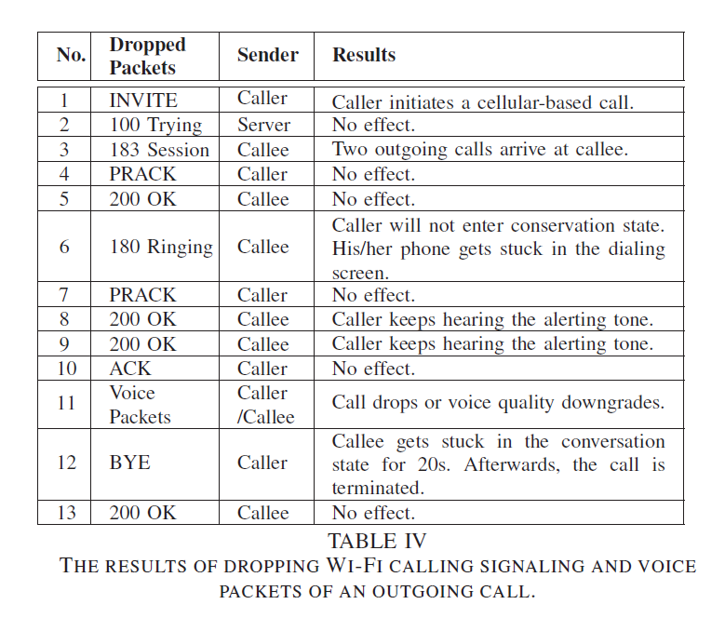
Notes:
SIP: session initiation protocol. PRACK: provision acknowledge
SIP: signaling protocol used for initiating, maintaining, terminating real-time session that include voice or video

Slide 19
Attack evaluation
Annoying incoming call attack
Zombie-Call Attack
Mute call attack
Telephony Denial-of-service attack
Notes:
They launch ARP spoofing attack and intercept the packet.
Based on identified traffic characteristic + call flow > able to identify specific signaling and voice packets.
So they discover 4 different type of attack by considering different pattern of packets to drop.

Slide 20
Annoying incoming call attack
Victim: callee
Receive multiple call from the caller
Drop: 183 session progress
Or Discarding: 180 Ringing
Notes:
Two approach:
1- 183 message sent by callee, the caller device initiate another volte call toword the callee.
2- 180 message send by the callee, the adversary can force the caller device to get stuck in dialing screen.
The caller cannot hear any alerting tone but the callee device would ring. Thus caller may keep redialing

Slide 21
Zombie-Call Attack
Victim: caller
The conversation cannot never started
Drop: 200 ok
Notes:
200 ok: send by the callee to indicate that the call has been answered.
That force the caller device to to get stuck in the dialing screen and keep hearing alerting tone

Slide 22
Mute call attack
Victim: both
Mute the victim speech
Dropping voice packets up to 8 seconds
Notes:
Doesn’t aim to terminate the call
If the voice suspicious time is longer than 8 sec,
it will be terminated by the network

Slide 23

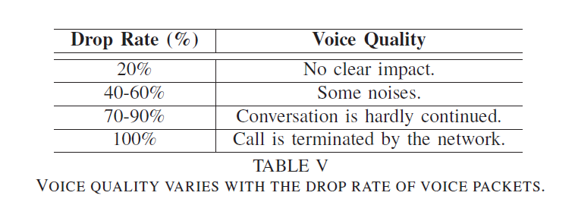
Telephony Denial-of-service attack
Victim: both
Downgrade the voice quality
Drop: voice packets 70% to 90%
Notes:
The conversation is hardly continued but still keep the call on

Slide 24
Recommended Solutions
1- using VPN service
2- upgrading wi-fi calling standards
Notes:
To mitigate security threat and address the identified security threat thoroughly
Short term and long term
VPN:
Because of the mixed traffic, It’s hard for adversary to infer information from call signaling and voice packet with vpn tunnel
Even though it reduced the damage, it doesn’t eliminate the risk completely. Quick remedy

Slide 25
Upgrading wi-fi calling standards
a- Devices should deploy necessary defense against common attack
Examine connection since not all attacks can be identified by the infrastructure
b- Devices & infrastructure should detect whether the user is under attack
by monitoring the quality of wi-fi calling services . Take action in case if anomaly detected
c- enhance SRVCC/DRVCC triggers
Consider service quality
Notes:
Security should be the top-priority feature in the wi-ffi calling standard cus traffic may cross insecure network
aiming to secure the network which is out of the operators control
But aim to identify insecure network and possible attack and take actions(ex: switching back to celluler)
These three mechanism for upgrade the standard:
A- arp spoofing.
B-action: switching to another wi-fi network or conventional celluler services. Infrastucture can update ANDSF
Update ANDFS and RAN rules to exclude malicious network
C- consider service quality not only radio quality. Since the service quality downgrade maybe caused by adversiries
Srvcc: single radio voice call continuity
Drvcc: dual radio voice call contiuity
Adversary has no control over the network used by the victim, the device or the celluler network infrastructure
The first two mechanism address v1 & v2. and third mechanism address v4. and when we removed these 3 vuln. Hopefully v3 wont be exist.

Slide 26
Conclusion
contribution
Vulnerabilities
Proof-of concept attack
Recommendation
Insecure network
ARP spoofing
Side channel attack
Radio quality only
User privacy leakage
THDoS
VPN
Upgrade standards
Notes:
Wi-fi calling services is thriving and being deployed worldwide

Slide 27
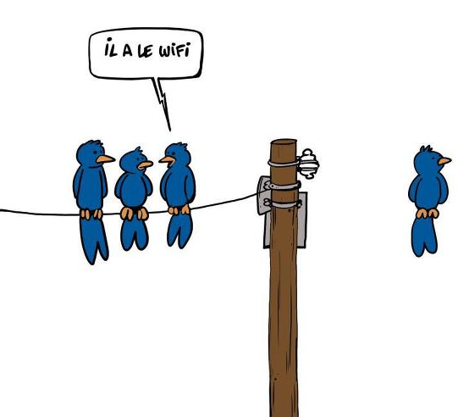
Q & A

